Slide 1
Design and Rationale of the Draft Proposed RISC-V Composable Custom Extensions Spec v.2023-08-06
Jan Gray Gray Research LLC jan@fpga.org
SPEC: https://github.com/grayresearch/CX/
Notes:
1 HELLO I'm Jan Gray
2 Today I’m presenting an overview of the design and rationale for our proposed specification for RISC-V Composable Custom Extensions

Slide 2
2019-2022 design contributors
Tim Ansell, Tim Callahan, Jan Gray, Karol Gugala, Olof Kindgren, Maciej Kurc, Guy Lemieux, Charles Pappon, Tim Vogt
Notes:
1 For the past several years, this group of RISC-V FPGA soft processor designers and users have met online to design standards for adding custom instructions to RISC-V soft processor cores, culminating in the present spec.

Slide 3
Introduction (§1)
Notes:
1 The outline of the talk follows the outline of the spec and there will be section numbers so you can follow along in the spec if you like.

Slide 4

RISC-V custom extensions’ reuse problem (§1)
Standard extensions layer and compose. But take years to ratify
Custom extensions: rapid in-house domain optimized solutions
… with incompatible opcodes, discovery, computation, state, error handling, tools, versioning, hardware signaling
RoCC, CV-X-IF, PCPI, SCAIE-V, MCUX, ACE, CODAL, …
Solution silos → fragmentation
Notes:
1 To appreciate the RISC-V Custom Extensions Reuse Problem,
2 Let's talk about RISC-V Extensions.
3 There is the RISC-V base ISA and standard extensions like floating point and atomics that layer and compose correctly on top of that.
4. There is also a community process to define a new standard extensions, which must be of general interest and broad utility and non-proprietary.
5 It can take a long time to define, refine, and ratify the extension.
6 In the end each new standard extension consumes some of the remaining 32-bit instruction opcode space and adds to the enduring complexity of RISC-V.
7 Now from the very beginning, RISC-V has also supported custom extensions.
8 The custom-0/1/2/3 opcode blocks will never be used by standard extensions.
9 That enables rapid development of domain specific problem optimized custom extensions and their software libraries.
10 This is very good and helps makes RISC-V an agile platform.
11 However, your custom extension and software may not work correctly alongside my custom extension and software, running together in one system.
12 We may have used the same custom opcodes for different purposes, and beyond that, we may have different means of extension discovery, models of computation, state, and error handling, different tooling, versioning systems, and different hardware logic interfaces, such as these here.
13 Unfortunately this leads to disjoint solution silos where we can't build on each other's good work, and to fragmentation of the ecosystem.

Slide 5
A mix & match composable custom extensions ecosystem (§1.1)
Agility of custom extensions + composability of standard extensions
Adopt some SW and HW interop standards so extensions coexist
Then anyone can define, develop, and/or use:
A new extension, its software libraries, its hardware implementations
A processor that uses any of these, a system composed of these
Tools for same
Notes:
1 Instead the specification enables and anticipates an ecosystem of mix and match composable custom extensions
2 where each combines the agility of custom extensions and the guaranteed correct composability of the standard extensions.
3 This will require that we adopt common software and hardware interoperation interfaces so that our custom extension solutions can coexist in one system. <>
4 If we do this then anyone, individual, company, school, or group, can rapidly define develop or reuse
5 a new custom extension, its software libraries, its hardware implementations,
6 CPUs that these all snap into, systems composed of these, and open tooling for same.

Slide 6
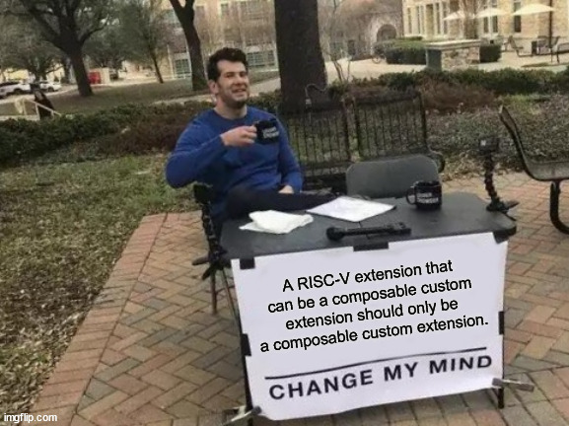
Keeping RISC-V simple, open, agile
Less pressure to add domain-specific standard extensions
Notes:
1 We also believe that guaranteed composable custom extensions can help keep RISC-V simple by reducing the pressure to add essential but domain-specific standard extensions.
2 Indeed we agree with this fellow whose soapbox is that a RISC-Vextension it can be a composable custom extension should only be a composable custom extension!

Slide 7
Key elements
Composable extension (CX): a composable custom extension’s interface contract
Composable extension unit (CXU): a hardware core that implements a CX
Composable extension library (CX lib): software that selects a CX, issues its custom instructions
Notes:
1 There are three key elements or concepts necessary to understanding the specification.
2 The first is a composable extension CX.
3 That's the interface contract of a composable custom extension.
4 It consists of the custom function instructions and the semantics of the custom extension, for example, the order the instructions must be issued.
5 It's immutable meaning once defined it must never change, and it's named with a unique 128-bit GUID. <>
6 Next is the composable extension unit CXU.
7 That's a modular reusable hardware core that implements one or more composable extensions. <>
8 Finally there's the composable extension library or CX lib.
9 That is software that first selects the current composable extension prior to issuing its custom instructions.

Slide 8
Example: Alice’s SoC (§1.2)
CPU Metadata
Switch MD
Crypt. MD
Configurable, composable hardware packages
CPU RTL
Switch RTL
Crypt. CXU RTL
System manifest
Composer
Accelerated System (Composed Hardware)
Accelerated Application (Composed Software)
Switch
Cryptography CXU <4>
Crypt. library
System CXU map
CPU₀ <2>
Compr. library
CPU₁ <2>
Runtime
FPGA A
Notes:
1 This shows how it all works together.
2 Alice is building a system on a chip.
3 She starts with a system manifest declaring her system shall have two CXU compliant CPUs, and a cryptography CXU, needed by her a cryptography library.
4 She obtains reusable packages for these cores and runs a Composer Tool which configures the cores and assembles them into processor complex according to the manifest.
5 The Composer also emits a System CXU Map with one entry indicating that the cryptography composable extension is available and is implemented by CXU number 0. <>
6 Alice's software application includes a crypt library and a compression.
7 The crypt library uses the runtime to discover that the cryptography extension is available and so it uses custom crypt instructions that issue to the Crypt CXU.

Slide 9
Alice’s SoC v2
CPU Metadata
Switch MD
Crypt. MD
Compr. MD
CPU RTL
Switch RTL
Crypt. CXU RTL
Compr. CXU RTL
System manifest
Composer
Accelerated System (Composed Hardware)
Accelerated Application (Composed Software)
Switch
Cryptography CXU <4>
Crypt. library
System CXU map
CPU₀ <2>
Compression CXU <4>
Compr. library
CPU₁ <2>
Runtime
FPGA A
Notes:
1 Next Alice updates the system manifest adding the compression extension package and rebuilds the system and System CXU MAP, adding a second entry for the compression extension and it’s CXU number 1.
2 Now when Alice runs the application both the Crypt library and the compression library discover that their respective extensions are present each issues their custom instructions upon their respective extensions’ CXUs.

Slide 10
Bob’s SoC
BCPU Metadata
Switch MD
Crypt. MD
Compr. MD
bobs_bnn_CXU MD
BCPU RTL
Switch RTL
Crypt. CXU RTL
Compr. CXU RTL
bobs_bnn_ CXU RTL
System manifest
Composer
Accelerated System (Composed Hardware)
Accelerated Application (Composed Software)
Switch
Cryptography CXU <4>
Crypt. library
System CXU map
BCPU₀ <2>
Compression CXU <4>
Compr. library
BCPU₁ <2>
bobs_bnn_CXU <4>
Bob’s ML library
Runtime
FPGA B
Notes:
1. Later Bob takes Alice's SOC and retargets it to a different FPGA from vendor B.
2 He upgrade the processors to B CPU cores.
3 He rebuilds the system (which just works).
4 Then Bob shudders, remembering how difficult this used to be. <>
5 After profiling the system, Bob realizes he needs to accelerate his ML inference library.
6 He designs a binary neural network composable custom extension, a CXU that implements its custom instructions, and a CX library that discovers selects and issues its custom instructions.
7 He builds his system again; now all three custom extensions and their libraries work together, each accelerating different parts of the workload.

Slide 11
Objectives ⇨ design rationale
Easy, robust, routine, boring composition
Across orgs, decades, platforms, tools
Decentralized
Diversity
Open, nonproprietary, free, limitless
Simple, frugal, fast
Stable binaries, stable RTL
Secure (privileged access control)
Promote uniformity …
Notes:
1 To appreciate the various moving parts of the specification, it’s helpful to understand our design objectives.
2 Of paramount concern was composition.
3 We could not use anything that would break correct composition.
4 It has to be easy robust routine even boring to add a composable extension to your system, without ever worrying the rest of the system may come crashing down.
5 As extensions, CPUs, CXUs, libraries will be authored across organizations, across decades, across platforms and tools, that constrained the solution space.
6 We wanted a decentralized solution, with no Central assigned naming or numbering Authority, no gatekeeping, no asking for permission.
7 We wanted to accommodate a diversity of RISC-V systems and workloads, from tiny MCUs to many-core Linux servers.
8 We wanted interfaces that are open and non-proprietary and free so that extensions can be reused across platforms and tools stacks.
9 We paid attention to efficiency, favoring the simplest possible mechanisms, the most hardware frugal mechanisms, and the fastest code paths.
10 We decided that composition should not require recompilation of libraries or regeneration of RTL cores. This is a fork-in-the-road decision.
11 When multiple extensions are composed together, you must do something so that for example their opcodes do not conflict.
12 One approach is to compute configuration specific assignments of custom function IDs, then recompile the libraries, or statically relink the application, fixing up conflicting indices.
13 We rejected this. It is too disruptive to software stacks and dev processes, and anyway people want to use one golden version of a binary across many systems configurations across the years.
14 Similarly, except for changing configuration parameters we don’t want to have to regenerate hardware composable extension unit cores each time it composed into a new system.
15 With the new focus on security we needed to provide operating system access control to grant or deny access to composable extension and state.
16 Finally we needed to promote uniformity across extensions …

Slide 12
Promote uniformity
Uniform naming (IDs), discovery, versioning
Uniform, unlimited, conflict-free instruction encodings
Uniform stateful extensions & uniform (no code) context save/restore
Uniform error signaling
Uniform access control
Uniform logic interfaces
Uniform metadata
One good enough way to do things vs. many incompatible ways
Notes:
1 By uniformity we mean that there should be one way of doing most things.
2 A uniform way of naming discovering and versioning extensions.
3 A uniform, unlimited, conflict-free way of encoding custom instructions.
4 A uniform means for managing the state and context save restore of stateful extensions.
5 Uniform error mechanism, access control.
6 Uniform hardware logic interfaces and metadata to make it easier to compose and test extension implementations.
7 In general one good enough way to do these things versus inventing many incompatible ways, and the fragmentation that comes with that.

Slide 13
New interop standards
ISA: HW-SW: composable extension multiplexing: -Zicx
A standard ABI for composition of CXs and CX libraries
Software first selects hart’s current CX & CX-state
Each CX enjoys full custom instruction encoding space
Non-ISA: HW-HW: CXU Logic Interface (CXU-LI)
A signaling standard for composition of { CPUs + CXUs } complexes
Better together
Notes:
1 Somewhat unusually we propose two interop interface standards layers.
2 Up in the ISA hardware-software interface is composable extension multiplexing, -Zicx.
3 That would be a standard ABI for composition of extensions and libraries that first selects the heart's current extension and state context prior to issuing its custom instructions.
4 Then each extension can enjoy the full custom instruction encoding space conflict-free. <>
5 A second non-ISA layer, at the hardware-hardware interface, the CXU logic interface, a signaling standard for reusing and composing CPUs and CXUs. <>
6 Note that these can be provided separately, or together.
7 You can imagine a processor with –Zicx extension multiplexing but using a proprietary means of adding composable extensions hardware.
8 Or a processor that doesn’t do extension multiplexing but adopt CXU-LI enabling resuse of the CXU ecosystem.
9 But overall, these two interop standards work much better together.

Slide 14
Standard interfaces and formats (§1.4)
CX Runtime: library services (discovery, state management, …)
-Zicx: “composable extensions” extension, new CSRs for CX multiplexing
CXU Logic Interface & metadata
Applications
-uses
CX₀ lib
CX₁ lib
CX₀
CX₁
CX-ABI
CX-RT
Language-VM / OS / VM
CXU Metadata
RV-I -Zicsr
-Zicx
SYS-MD
CPU-MD
CPU
CXU₀-MD
CXU₁-MD
CXU Logic Interface
CXU₀
CXU₁
Notes:
1 This illustrates where the new interfaces fit into the HW-SW stack.
2 The first is the CX runtime or CX-RT here.
3 This provides common CX library services including extension discovery, selection, and State Management.
4 Then there’s –Zicx, which you might think of as the composable extensions extension which combines custom instructions with new CSRs that provide extension multiplexing.
5 Down in the hardware, the CXU logic interface and metadata provide glueless automatic composition of cores into systems.

Slide 15
Scope: what kinds of custom extensions? (§1.3)
Invariant under composition ⇨ isolated ones
V1: custom function instructions: int registers & an isolated state context
None of: float regs, vector regs, memory, CSRs, PC, exceptions
Cf. RoCC, CV-X-IF, PCPI, SCAIE-V, MCUX, ACE, CODAL, … ⇨ another presentation
Notes:
1 The scope of our work, that is what kinds of custom extensions can we support, was the subject of much debate.
2. As this is a composable extensions specification we support extensions that are invariant under composition.
3. That is, extensions whose behavior do not change when combined with others.
4 The common property of such extensions is that they are completely isolated from each other or *shared nothing*.
5 So for version 1 of the spec the scope is narrowly defined as extensions whose custom function instructions access only the integer registers plus a isolated extension state.
6 We do not currently support custom extension access to the floating point or vector registers, memory, CSRs, the program counter, instruction flow generally, or exceptions. <>
7 It's very interesting to compare our design to some of the other non-composable extension systems but that's the subject of another presentation

Slide 16
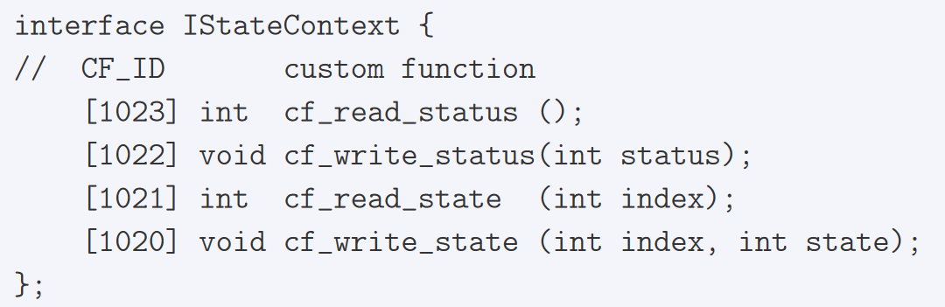
Stateful composable extensions (§1.3.1)
Custom function instructions may R/W current state context data, including private RAM and registers
Each CX/CXU configured with n isolated state contexts
IStateContext (§1.4.4) standard CF instructions for uniform access to state
Notes:
1. The design supports both stateless and stateful custom instructions in composable extensions.
2 Custom function instructions can read or write state context data of an extension,
3 Which can include private RAM, register files, and registers.
4 But this state is private and isolated to that extension, inaccessible to anything else in the system.
5 Within a system, each composable extensions and its CXU are configured with some number of State contexts.
6 There can be zero, one, one per hart, or even a pool of a thousand contexts.
7 It’s up to the system designer.
8 So you have multiple State contexts, per extension, per system. <>
9 The spec also defines four standard custom function instructions called IStateContext that provide uniform access to the state of stateful composable extensions.
10 More on that in a later slide.

Slide 17
CX (V1) scenarios: more than meets the eye
Stateless
Bitmanip: X[rd] = f(cf, X[rs1], X[rs2]/imm) – all of Zba Zbb Zbc Zbs
Stateful
CSRs: X[rd] = f(cf_write_state, X[rs1], X[rs2]) – CX csrrw
Reduce: (X[rd],A) = f(cf, A, X[rs1], X[rs2]) – dot product, multiprec math
Vector: V[rd] = f(cf, V[rd], V[rs1], V[rs2]) – vector-regfile state {X,V}[rd] = f(cf, V[rs1], X[rs2]) – put/get elements
4r1i: (i,a,b) = ({cf₀,custom}, X[rs1₀], X[rs2₀]) – 2 instruction sequence X[rd] = f(cf₁, X[rs1₁], X[rs2₁], i, a, b)
Channels: X[rd] = putget(chan[cf.chan], cf.{put,put2,wait}, X[rs1], X[rs2])
f(RAM): put-data*; operate(data)*; get-data* – crypto, ML, …
Async: FSM = f(cf₀, …); . . . . .; X[rd₁] = f(cf₁, FSM, X[rd₀], …)
CPU support for CX V1 enables so much for so little
Notes:
1 Now this scoping seems very narrow and limiting.
2 All you get is access to integer registers and some state -- but you can actually accomplish a lot with such composable extensions.
3 For example the entirety of the bitmanip specification are stateless custom functions of two integer registers and an immediate.
4 Yes, bitmanip could have been a composable extension. <>
5Then looking at some stateful examples, <>
6 Extension state registers provide simple, composable, uniform extension CSRs. <>
6 State supports reductions, where the extension keeps a running sum, or other work in progress state, so that’s dot products and multi-precision math, without resort to three source register operands. <>
7 Since a CXU can access both a custom function ID and the raw instruction word, it can recode and arbitrarily reinterpret the fields of the custom instruction.
8 So this supports a vector extension with private vector register file state contexts, and custom instructions which operate and any mix of vector registers and integer registers. <>
9 State enables cascading input operands across custom instructions; here a two instruction sequence feeds a custom function of four registers and an immediate. <>
10 The state of an extension can be one or more channels, with message passing custom instructions composing the system with stream accelerators or other processing elements.
11 In general any extension with private RAM can use custom instructions to write the RAM, to operate on data blocks in RAM, and to read the out results data. This supports block compression and encryption, and matrix multiplies. <>
12 State also enables async extensions where some custom instructions begin long running operations and complete, while others block (or not) awaiting each result.
13 So with a very simple change to a processor – routing ALU source operands out to a CXU request, and muxing CXU responses into destination register writeback, you enable diverse scenarios at low cost and complexity.

Slide 18
Scope: V2 ideas, directions
Compose V1 with PULP stream semantic registers
Access memory: CXU⇨CPU; precisely ordered; disjoint/isolated regions
Enable custom instructions beyond custom-[012] opcodes
Register pairs e.g. (X[rd],X[rd+1])
Speculative issue / cancelation of stateful custom instructions
Notes:
1 That said, in the long term a composable extension facility should address more scenarios and access to other RISC-V resources.
2 Here are some discussions we have had that are not in the spec.
3 A preview of things to come.
4 First, it would be very powerful and complexity effective (and area frugal) to add the PULP stream semantic registers and zero overhead loops to CX V1, efficiently streaming memory based operands through extensible CXU datapaths. <>
5 Or to enable a composable extension to directly access shared memory, an additional CXU to CFU request/response processor would ensure correct interleaving of CPU instruction memory accesses with the memory accesses of the custom instructions.
6 To preserve composition, it would help to have a means to allocate disjoint isolated shared memory regions across extensions. <>
7 Perhaps we need a way to specify composable extensions’ instructions beyond the custom opcodes.
8 Adding register pairs, at least to CXU response writeback, would afford higher bandwidth access through a CXU.
9 Finally, the CXU logic interface does not currently support speculative issue and cancelation of stateful custom instructions.
10 We may want to enhance it to do so.
11 With so much yet to do adopting V1, we don’t need to decide these questions now but keep them in mind to simply a later evolution to a more expansive V2 scope.

Slide 19
Composable extension multiplexing Collision-free custom instructions
mcx_selector ::= hart’s current (CX/CXU, state)
CX lib: csrw mcx_selector; then custom-[012];* issues requests to the CXU
CXU performs each request, updating its state; write dest reg & cx_status
mcx_selector CSR cx_status CSR
cx_reg cf_id,rd,rs1,rs2 cx_imm cf_id,rd,rs1,imm cx_flex cf_id,rs1,rs2
Notes:
1 Now finally after all these preliminaries and rationale we will discuss composable extension multiplexing in detail.
2 It's quite simple: there's a new CSR called MCX selector which is programmed with the hart’s current CXU_ID and state ID prior to issuing custom instructions.
3 MCX selector determines which CXU processes this hart’s custom function instructions.
4. This is analogous to the vector extensions’ set VL prefix, which changes the behavior of other vector instructions in its wake.
5. As custom instructions issue they are turned into CXU requests, which are sent to the hart’s selected CXU.
6. That cxu performs each request, possibly updating some isolated local state, and then the CXU response data is written back to the destination register.
7 The CX status register accumulates CXU errors;
8 CX status is analogous to the floating point fcsr register which accumulates floating point errors. <>
9 Now when custom extension multiplexing is enabled it changes the behavior of the custom 0 1 and 2 instructions.
10 Custom 0 becomes CX reg, which sends a 10-bit function ID and two source operands to the CXU and writes a destination register back.
11 cx_imm sends a function ID, a source register, and an immediate value.
12 CX Flex sends two Source operands but does not write a dest register.
13 CX Flex is used to provide up to two source operands to an extension, as well as a 25-bit custom opcode field that the extension interprets as it likes.

Slide 20
Multiplexing in detail The SW⬄ HW interface
instruction
CPU
cx_reg cf_id rd rs1 rs2
register file
mcx_selector
csrw mcx_selector,x1 cx_reg 101,x4,x2,x3 cx_reg 102,x7,x5,x6 …
csrw mcx_selector,x10 cx_reg 11,x14,x12,x13 cx_reg 12,x17,x15,x16
…
cxu_id state_id en=1
cx_status
ALU
cu op fi of si ci
request
id cxu state insn func data0 data1
state contexts
datapath
CXUs
response
id status data
Notes:
1 This illustrates extension multiplexing in more detail.
2 Running the code on the left, we've just moved the value of X10 into MCX selector and now we’re executing the CX reg custom instruction that follows.
3 This creates a CXU request comprising the CXU_ID and state ID from MCX selector, the raw instruction and function code of the instruction, and two source data operands for the register file.
4 This request selects a CXU, a state within that CXU, and provides the operands to perform the selected custom function, possibly updating the state.
5 Response data is written back to the destination register and any error repsonse status is accumulated in the CX status register.

Slide 21
CX Runtime and CX ABI (§1.4.5)
CX libraries use CX Runtime services
Discovery: map CX_ID (GUID) ⇨ CXU_ID, if present
State: alloc/free, save/reload a state context
Change CX selectors
Access control
Runtime services, in software, keeps hardware frugal
CX ABI
-V setvl analogy: csrrw mcx_selector prefixes groups of custom instructions
mcx_selector: callee save, restore on stack unwinds
Basic: scoped by C++ RAII object constructor/destructor
Better: compiler inserts and optimizes mcx_selector writes
Notes:
1 This extension multiplexing mechanism is necessary but insufficient to implement composable extensions and their libraries.
2 The CX runtime library is a set of common services provided to CX libraries.
3 Services include extension discovery which maps an composable extension GUID to a system-specific CXU_ID index;
4 State Management, managing state context IDs, as well as context save and restore of any extension state context;
5 Managing CX selectors; and
6 Access Control to extensions and state.
7 The runtime is implemented in software to keep extension hardware simple and frugal. <>
8 The CX application binary interface pertains to mcx_selector.
9 To support nested function calls among composable extensions libraries, the ABI requires callee save behavior: if a function changes the hart’s current mcx_selector, it must restore the original selector value upon return.
10 This must also occur on stack unwinding including C++ exception handling.
11 You can use a C++ RAII object to represent that scope nesting, in the Constructor write the new selector, and in the destructor restore the original selector.
12 This works in lieu of CX ABI aware compiler support, but iin time we may use such a compiler to insert and optimize CX selector writes.

Slide 22
Example CX programming model C++ RAII object to scope the custom instructions
Try to select the IBitmanip CX, issue its custom instructions, deselect it
if (CX cx(IBitmanip_CX_ID); cx) // CX(): csrrw x1,mcx_selector,x2 count = cf(pcnt, data, 0); // cx_reg pcnt,rd,data,x0 // ~CX(): csrw mcx_selector,x1 else count = popcount(data); // no CX/CXU: use software
Better: retain selector values
Notes:
1 Here's an example CX programming model.
2 This is not the particularly efficient but it illustrates many of the features.
3 Here again we use a C++ RAII resource acquisition is initialization object to scope the extension’s custom instruction execution.
4 This code discovers whether the IBitmanip extension, identified by its GUID, is configured in this system.
5 If so, it writes mcx_selector, selecting the extension, then issues a custom popcount instruction, and then in the destructor, restores the original mcx_selector value.
6 If not, it fall back to a software popcount function.
7 Now if you do this in a loop it redundantly maps from CX_ID to CXU_ID each iteration. Not very efficient.
8 In practice you would hoist extension discovery out of the loop and do it once when loading the library, or once per function call into the library.
9 Alternately a CX aware compiler will can do these optimizations for you.

Slide 23
Versioning story (§1.6)
Over decades, change happens (AVX, Direct3D12)
A CX is a named, immutable interface contract
Any change is a new CX, so you mint a new CX_ID
A CXU may implement >1 CX, e.g., old and new CX contracts
Negotiation: CX lib asks CX Runtime for CX₂ else CX₁ else fails
Notes:
1 An important dimension of composition is composition across the years.
2 Sometimes the software client of an extension and the hardware implementation of the extension are re separated by decades.
3 Imagine in 2035 a 2035 library using an extension and CXU from 2023,
4 or a 2023 library using a 2035 CXU. 5 In addition over time our understanding thebest composable extension for a given problem domain will evolve.
6 There have been many flavors of SSE and AVX, and at least 12 generations of Microsoft’s 3D graphics APIs.
7 So we have to anticipate that a 2023 composable extension will change by 2028 and again by 2033.
8 How can we make that work well across the years, with new and old libraries using new and old extension versions?
9 First, a library should only use the composable extension versions it has been tested with.
10 And a library may want to use a new extension if possible, falling back to an older version otherwise.
11 In the spec, a composable extension is a named and immutable interface contract.
12 So if you make changes to an extension, for example, adding a new custom function instruction or changing the behavior of an instruction, you actually defined a new composable extension.
13 It was Foo version 3, now its Foo version 4.
14 All you have to do is give the new extension a new CX ID., which is just minting a new 128-bit GUID.
15 Since a CXU may be able to implement old and new extension contracts for almost the same gates or LUTs, a CXU may implement multiple CXs (distinguished by one of several different CXU_ID values for that CXU core).
16 This also leads to a style of extension discovery in the extension library.
17 It asks the Runtime for the new version of the extension; if not configured,
18 It asks the Rutnime for some previous version of the extension; and so on.
19 Thus an extension library and the extension implementation, written by different organizations in different decades, can dynamically determine the best, most up-to-date extension that's mutually supported by both of them.

Slide 24
Inspired by Microsoft Component Object Model (§1.9)
Framework for composition of 100s of diverse software components
Proven at scale for three decades across Windows, Office, DirectX
In common with CX proposal
Immutable interface contracts, self-named by GUIDs ✓
Components implement 1+ interfaces ✓
Separately authored, separately versioned, substitutable ✓
Dynamic discovery affords best-interface negotiation ✓
Notes:
1 All of this interface negotiation stuff seems pretty esoteric but in my experience it works well.
2 It is inspired by the Microsoft component object model also called COM.
3 COM is Microsoft's framework for disciplined software component reuse and it's used across hundreds of diverse libraries in the Microsoft ecosystem.
4 It's been proven at scale for three decades across Windows and Office and DirectX games and so forth.
5 Here are some COM ideas present in the composable extension spec:
6 This notion of immutable interface contracts that are self named by GUIDs
7 Components that can Implement one or more interfaces;
8 Separately authored separately versioned components that are substitutable, enabling multiple implementations of a given interface, and
9 The use of dynamic discovery to find the best interface negotiation across time and space.
10 Long industry experience with this model give me confidence that this is a sound model for enduring composition of separately authored composable extensions

Slide 25
Composable Extensions / -Zicx (§2)
Notes:
1 Now having completed our exploration of the non-normative Introduction,
2 we now turn to section two, the –Zicx spec, enabling composable extensions at the hardware software interface

Slide 26
Four new CSRs (§2.2)
M-mode composable extension multiplexing
Access controlled custom extension multiplexing
mcx_selector cx_status
mcx_table cx_index
Notes:
1 The specification proposes four new csrs for zicx.
2 We've already spoken about MCX selector and CX status.
3 In addition there are two more CSRs that support *access control* to extensions and their state.

Slide 27
mcx_selector CSR
mcx_selector
.en=1 enables composable extension multiplexing
.en=0 custom-0/1/2 does whatever it already does on this CPU
.cxu_id selects current configured CXU
.state_id selects current state context of that CXU
Only accessible in machine mode
Notes:
1 Starting with MCX selector,
2 This has three fields, a one bit enable, an 8-bit cxu ID and an 8-bit state ID.
3 The enable bit enables custom extension multiplexing. When 1, extension multiplexing is on and custom instructions issue CXU requests. When 0, multiplex is off and the custom 0 1 and 2 instructions do whatever they already do on this particular CPU.
4 This enables composing composing legacy custom extensions with newfangled composable extensions.
5 The cxu_id field selects the current configured CXU.
5 It is an index from 0 to number of configured extensions minus one;
6 The state ID field selects the current state context within the selected CXU.
7 mcx_selector is only accessible in machine mode.

Slide 28
cx_status CSR
cx_status
Accrues CX/CXU error status flags (CXs don’t raise exceptions, cf. fcsr)
R/W in all priv modes
Set when mcx_selector.en=1 and a custom-[012] instruction error
.CI: invalid cxu_id
.SI: invalid state_id
.OF: that state context is OFF
.FI: no such custom function
.OP: operation error, e.g., divide by zero
.CU: (stateful CX) custom error: errno etc. via IStateContext::cf_read_status/state
Notes:
1 CX status CSR accumulates error status flags carried back in a CXU response.
2 It is read write in all privileged modes.
3 Typically software will zero the register, perform one or more custom instructions, and then read it back to determine if anything went awry.
4 Error flag fields in CX status are set when MCX selector is enabled and an error occurs during execution of a custom function instruction.
5 If MCX selector contains an invalid cxu or state index that will set CI or SI;
6 If the selected state context is in the OFF state that will set OF;
7 Issuing a custom function that's not implemented in the CXU sets FI;
8 An operation error like divide by zero sets OP.
9 And new private error state, such as per-CXU errno, sets CU.
10 If CU is set, a CX library may use IStateContext read_status / read_state to obtain the custom error state.

Slide 29
Access controlled CX multiplexing CSRs (§2.7)
mcx_table cx_index
Grant/deny unpriv software access to CXs and CX state
+ Deny inferring CX use in other harts – deny certain side channel attacks
Unpriv: change CX selector with one CSR write, no OS detour
Priv OS: at *mcx_table keep hart’s 4 KB = 1024 CX selector table, unpriv inaccessible
Priv OS: provides opaque CX selector indices to unpriv user code
Unpriv: csrrw old_index=x1, cx_index, x2=new_index
CPU: mcx_selector = mcx_table[cx_index] “at next priv mode”
Prefer cx_index writes to mcx_selector writes
Notes:
1 The spec proposes two additional CSRSs MCX table and CX index that allow privileged operating system code to Grant or deny unprivileged software access to composable extensions and their state.
2 They also obscure other hart’s extension usage which denies certain side channel attacks.
3 The purpose of these CSRs is to allow unprivileged software to change OS-managed CX selectors with one CSR write, with no OS detour.
4 The privileged operating system creates, for each hart, a four kilobyte table of 1024 valid CX selectors.
5 It maps the table inaccessible to unprivileged code and writes the table address to MCX table CSR.
6 The privileged OS manages the table entries and returns opaque table indices to unprivileged code.
7 The unpriv code cannot write mcx_selctor but can write cx_index.
8 In response the CPU loads the corresponding MCX table entry, using the next privileged mode, writes that selector value into mcx_selector on behalf of unpriv code.
9 To be determined: whether all -Zicx systems must implement all four CSRs or whether austere M-mode only processors may leave out these two access control CSRs
10 and which csrw instruction to use to change extension selectors.

Slide 30
CX custom function instruction encodings (§2.3)
cx_reg cf_id,rd,rs1,rs2 cx_imm cf_id,rd,rs1,imm cx_flex cf_id,rs1,rs2 (cx_flex25 custom)
Ripe for discussion / redesign
Future proofing? Anticipate V2+ needs
Notes:
1 Now we've already introduced these three custom function instruction encodings used with extension multiplexing.
2 Note there is considerable interest in redesigning these particular opcode assignments, which bits go where and so on,
3 interest in making the register field dependencies optional,
4 in signaling that a given instruction is stateless or safe to issue speculatively, and so forth
5 Please refer to the notes in the spec.
6 Also, looking ahead, we may decide to allocate some custom opcode blocks for non-multiplexed access to conventional custom extensions,
7 some for composable extensions V1, and keep some in reserve for future composable extensions versions.

Slide 31
Implicit fences (§2.2.5), precise exceptions (§2.3)
Implicit fence between CX CSR access and any custom-[012] instructions
CX CSR access “happens-before” custom instructions*
custom instructions* “happens-before” CX CSR access
E.g., csrr cx_status awaits responses of prior custom instructions
Precise exceptions vs. speculative issue of stateful custom instructions
Notes:
1 We must be careful, and precise, about interactions between instruction execution in the CPU pipeline and execution of these extension custom instructions.
2 What degree of pipelined, concurrent, or asynchronous execution of these units is desirable?
3 How is it managed?
4 The spec promises an implicit fence between composable extensions CSR accesses and any subsequent custom instructions, and vice versa,
5 so a CX CSR access must happen before the custom instructions that follow and
6 custom instructions sequences must happen before CX CSR accesses that follow.
7 So for example a CSR read of CX status must await CXU responses from any prior custom instructions.
8 Similarly there's an interaction between precise instruction exceptions and speculative issue of stateful custom instructions, which governs issuance of such instructions.
9 Please see the notes in the spec.

Slide 32
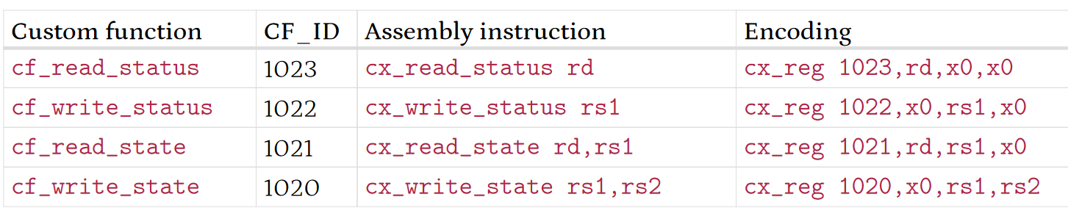
IStateContext
Each stateful extension must include these CF instructions
cf_{read,write}_status accesses state context status word:
.cs (like mstatus.XS): 0:off 1:initial 2:clean 3:dirty
cf_{read,write}_state to save/restore raw state context data
Notes:
1 The specification proposes a standard interface, IStateContext, with four standard custom function instructions that read and write extension status and state.
2 Each stateful composable extension implements these four custom function instructions.
3 Read status and write status access a standard state context status word, indicating the operating status of the extension,
4 The .CS field can be off, initial, clean, or dirty. This echoes mstatus.XS.
5 The .state_size field indicates the state size (XLEN words) necessary to do a context save of this stateful context.
6 and the .error field is an 8-bit errno for the extension’s most recent stateful error.
7 Then Read state and write state custom function instructions enable an operating system to uniformly save and restore a state context of any stateful custom extensions.

Slide 33
Composable Extension Unit Logic Interface (CXU-LI) (§3)
Notes:
1 The next section of the specification defines the standard hardware-hardware interop interface called the composable extension unit logic interface

Slide 34
CXU-LI objectives ⇨ design rationale
Modular, platform neutral, composable extensions’ implementations
Compose CPUs+CXUs without changing CPU+CXU RTL
Handle diverse CPUs (pipelines) and CXUs
LUT frugal
Promote uniform signaling, naming, configuration, validation, metadata
Notes:
1 First let’s review some CXU-LI design objectives.
2 An ecosystem of composable extensions requires modular, reusable, platform neutral, extensions hardware cores, our CXUs.
3 We must be able to automate composition of complexes of CPUs and CXUs,
4 And do so without having to change or revalidate any CPU or CXU RTL.
5 We must handle diverse CPUs microarchitectures, from simple MCUs up to complex out of order multi-issue processors,
6 And diverse extensions, with ALU-like things, or with deeply pipelined stateful matrix multiplies.
7 The interface signaling must be extremely gate and LUT frugal, so they're affordable in tiny systems and affordable in many core systems,
8 And as before we must promote uniformity: uniform port signals, naming, parameters, reusable validation tests, and uniform CXU metadata.

Slide 35
Zen of CXUs
A CXU implements one (or more) composable extensions
CPU custom-*⁺ ⇨ CXU requests ⇨ CXU ⇨ CXU responses ⇨ CPU
Configurable width, latency, state, … – described in metadata
CXU Logic Interface feature levels
0: combinational; 1: fixed latency; 2: variable latency; 3: reordering
Each CXU and CPU speaks a specific CXU-LI level
Composition: CPUs ⬄ switches & adapters ⬄ CXUs
Notes:
1 Here are CXUs in a nutshell.
2 A CXU implements one or more composable extensions.
3 A CPU issues one or more custom function instructions, each a CXU request, routed to the selected CXU, which performs the requests in order, and sends CXU responses back to the CPU , updating destination registers and CX status.
4 CXUs are highly configurable with parameters like port widths, latency, and state context counts,
5 with valid parameters values described in CXU metadata.
6 The CXU logic interface supports different CXU feature levels reflecting different levels of sophistication of CXUs.
7 It efficiently supports combinational CXUs, pipelined fixed latency CXUs, variable latency valid-ready handshake streaming CXUs, and response reordering CXUs.
8 A given CXU or CPU all speak a specific CXU-LI level,
9 Then systems are composed from these using provided parameterized switch and adapter CXUs.

Slide 36
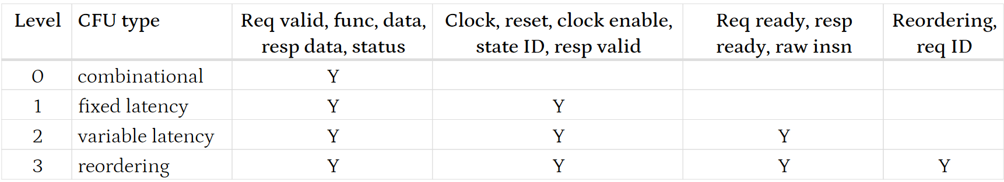
CXU-LI feature levels (§3.3)
Keep simple use cases simple and frugal, make complex use cases possible
Accommodate simple or complex CPUs, simple or complex extension
Notes:
1 The four CXU-LI feature levels are stratified to factor out boilerplate complexity and overhead, to keep simple cases simple and frugal, while still supporting complex use cases possible.
2 Therefore we care about, and support well and efficiently, simple and complex CPUs and simple and complex CXUs.
3 Level zero is combinational CXUs, with ports signaling the requested CXU, function, and data operands, and with response data and status.
4 Level one is fixed latency clocked CXUs which add clock, reset, clock enable, a state ID, and a response valid signal.
5 Level two is variable latency streaming CXUs, adding valid-ready handshakes on requests and responses.
6 Level three is response reordering CXUs.

Slide 37
CPUs × CXUs composition (§3.2)
CPUs ⬄ switches & adapters ⬄ CXUs
Powered by CPU & CXU packages’ metadata
CPUs and CXUs can request CXUs; CXUs form a DAG
CXUs composition = configuration constraint satisfaction, else infeasible
E.g.: CXU-L1 CPUs + CXUs: find a feasible system-wide CXU_LATENCY
Switch
CXU₀ <4>
CPU₀ <2>
Switch
CXU₁ <8>
CXU₂ <4>
CPU₁ <2>
Cvt12
CXU₃
CXU₄
Requester
Responder <contexts>
Notes:
1 The CXU LI enables automatic composition of CPU and CXU complexes.
2 Composition configures the CPU and CXU RTL modules with compatible parameter values, then inserts switch and adapter CXUs use to wire everything together.
3 This is powered by CPU and CXU package metadata which defines feature levels and feasible parameters for each component.
4 Since both CPUs and CXUs can issue requests to other CXUs, the CXUs in a system form a directed acyclic graph. <>
5 In this example there are two CPU cores. Each can issue requests to any of 5 CXUs.
6 Each CXU implements one or more composable extensions.
7 In this figure notice the angle brackets notation which indicates how many harts or state contexts are configured in each of component.
8 Here each CPU core has two harts, a total of four harts in this system.
9 Therefore the system designer built the system manifest to specify that each stateful CXU has a separate state context for each of hart.
10 So CXU0 and CXU2 each have 4 state contexts.
11 CXU1 has 8 state contexts, 4 for the CPU harts and 4 for the 4 state contexts of its CXU2 client.
12 CXU3 and CXU4 are stateless and have zero state contexts
13 Note that CXU3 is feature level 1 while the rest of the components are feature level 2.
14 Therefore the first step of composition is to insert an adapter core to raises CXU3 from feature level 1 to feature level 2. <>
15 Now All That Remains is to insert to switch CXUs. <>
16 The first routes requests from the CPUs to all the CXUs, while the second routes requests from the CPUs or CXU2 into CXU1.
17 In summary composition of CXUs is a configuration constraint satisfaction problem and
18 In some cases there is no feasible solution, for example if a CPU could only support a CXU_LATENCY of 1 cycle and a CXU could only support CXU_LATENCY of 2,3,4 cycles, automatic composition fails.

Slide 38
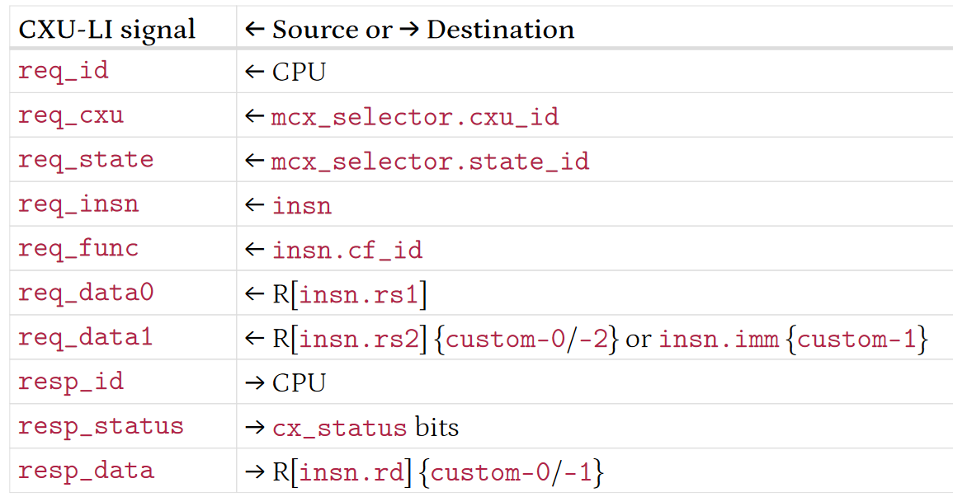
CXU-LI HW-SW interface, again
instruction
CPU
cx_reg cf_id rd rs1 rs2
register file
mcx_selector
cxu_id state_id en=1
cx_status
ALU
cu op fi of si ci
request
id cxu state insn func data0 data1
state contexts
datapath
CXUs
response
id status data
Notes:
1 Here we recall the custom extension multiplexing figure discussed earlier.
2 Let’s consider how that translates into the signals of CXU-LI.
3 Reviewing the request and response ports in the table on the right,
4 req_id is provided by the CPU itself,
5 req_cxu and req_state from mcx_selector
6 req_insn and req_function from the instruction,
7 data0 and data1 from the register file or an immediate.
8 The resp_id is just the req_id
9 resp_status is merged into cx_status, and
10 resp_data is written back to the destination register.

Slide 39
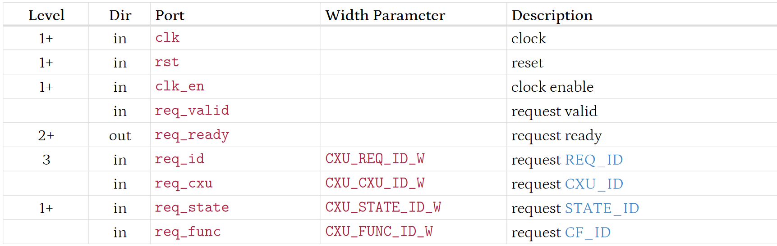
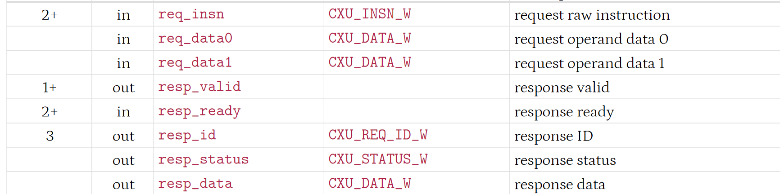
CXU-LI port signaling
Notes:
1 This table summarizes CXU-LI request and response port signaling.
2 For each Port we see at what feature level that Port is introduced.
3 Some ports have a configurable width parameter, for example you can configure CXU data to be 32 or 64 bits wide.
4 Some ports (such as req raw instruction) are optional and may be elided with a width parameter of 0 bits.

Slide 40
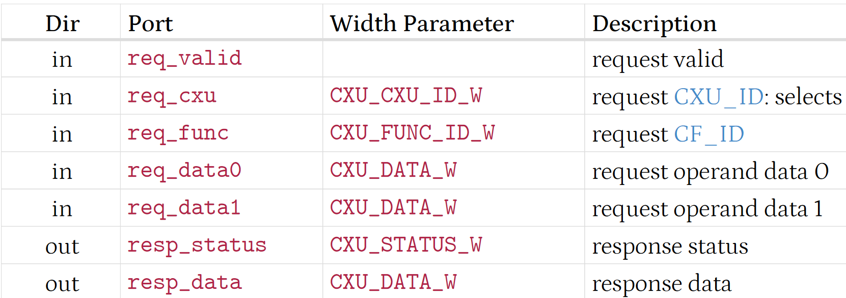
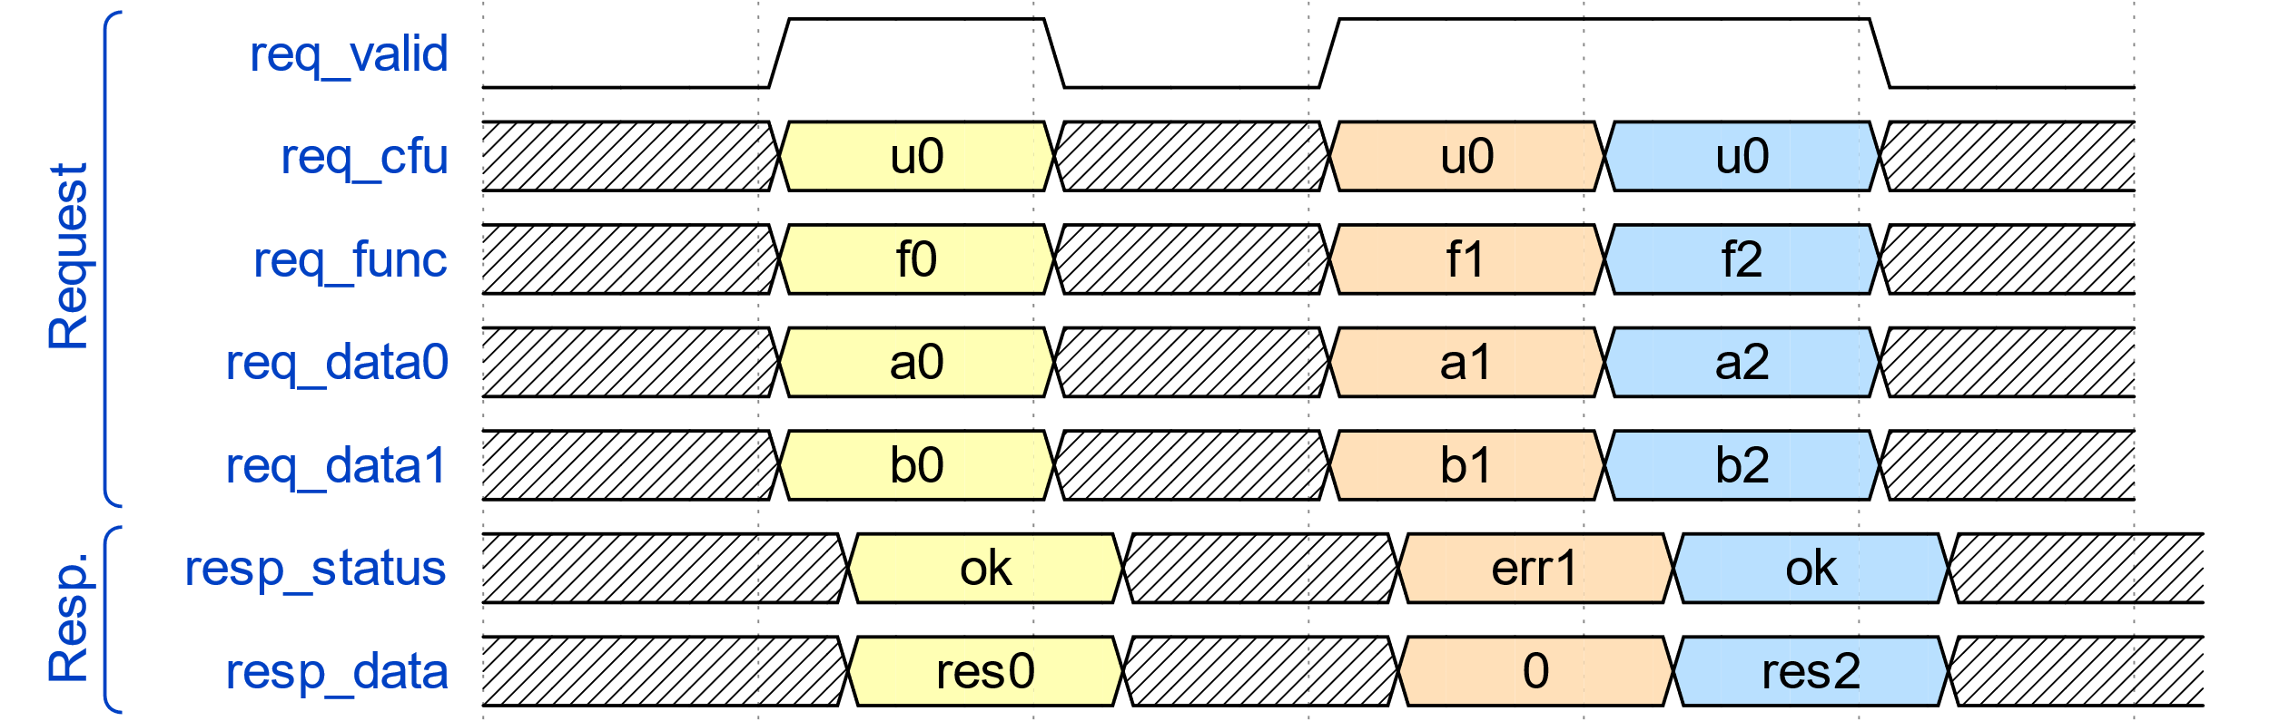
CXU-L0: combinational CXU (§3.5)
Stateless composable extensions only
Combinational function of the CXU request
Send response after comb. delay
Notes:
1 Now we briefly consider the four CFU-LI feature levels with simple waveform examples.
2 The first is CXU level 0, combinational CXU.
3 This supports only stateless extensions because there is no clock.
4 It computes a combinational function of the request function and the data, and it sends a response status and data after a delay

Slide 41
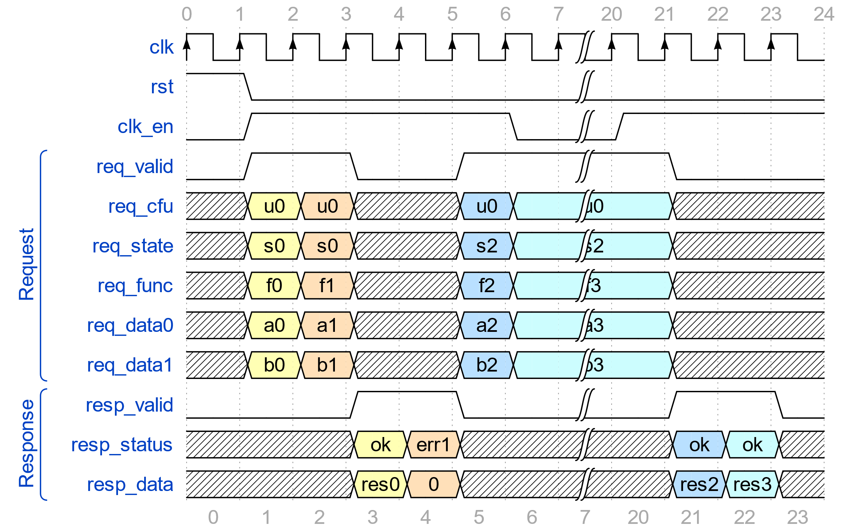
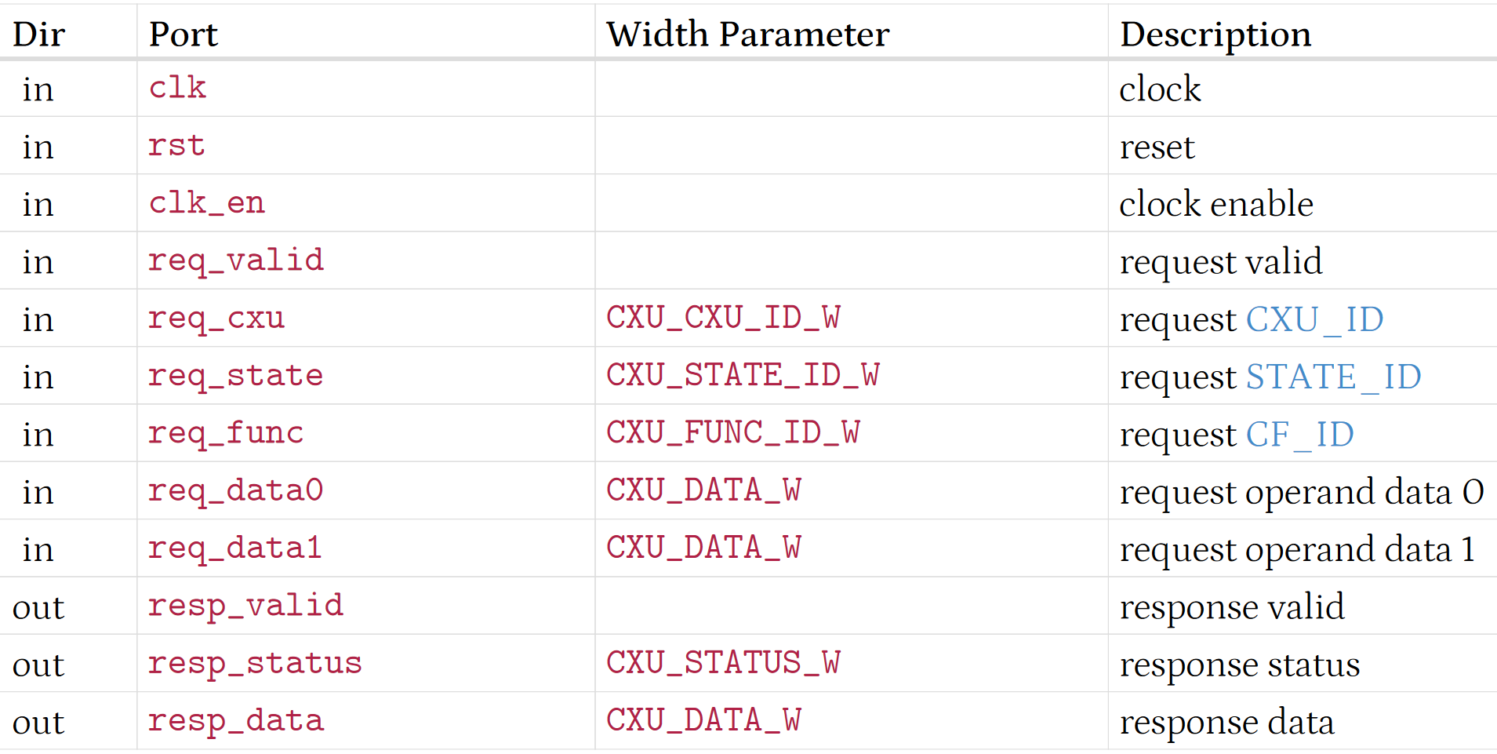
CXU-L1: fixed-latency (pipelined) CXU (§3.6)
Compute function of request and state; send response after CXU_LATENCY cycles
Initiation interval=1/cycle. No flow control
Clock gating to save power: clk_en=0 suspends CXU interface and internals
Notes:
1 CXU level 1 supports fixed latency clocked pipeline CXUs.
2 The CXU computes a function of each request and its private state if any, possibly updating the state, and sends a response after the the parameter “CXU latency” cycles.
3 Some CXUs support a CXU latency down to zero cycles meaning they can respond in the same cycle as the request.
4 The initiation interval is one per cycle which so the CXU is can process a request every cycle.
5 There is no flow control.
6 Clocked CXUs do have optional clock gating to save power.
7 Negating the clock enable input suspends the CXU interface and internals.
8 This works well on FPGAs whose flip-flops all have a free clock enable input.
9 In the waveform at right, the CXU has a CXU latency of 2 cycles.
10 The first two requests arrive in cycles 1 and 2, with to responses in cycles 3 and 4.
11 The next two requests arrive in cycles 5 and 6 but then clock enable is negated, freezing the interface through cycle 20.
12 The final two responses are sent in cycles 21 and 22.

Slide 42
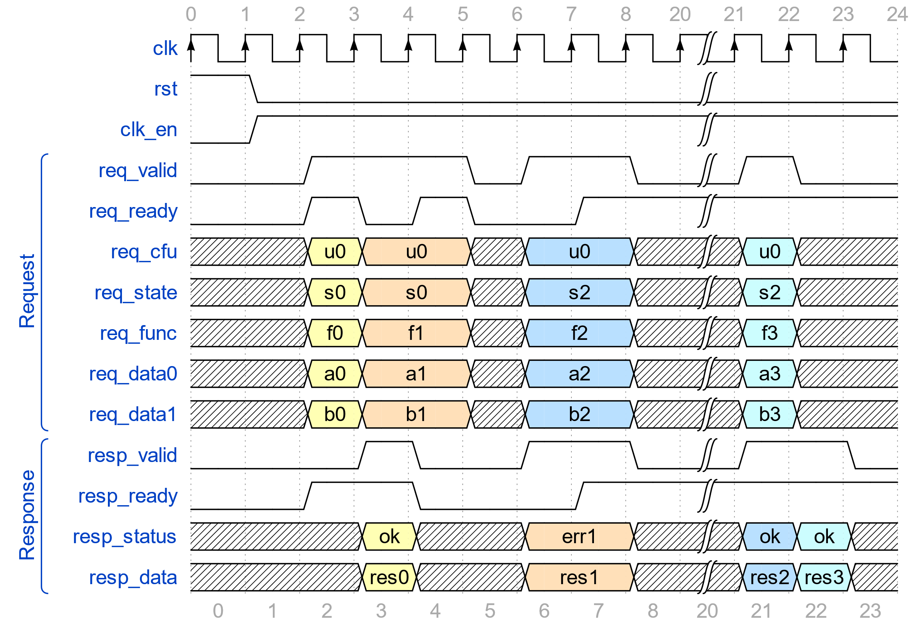
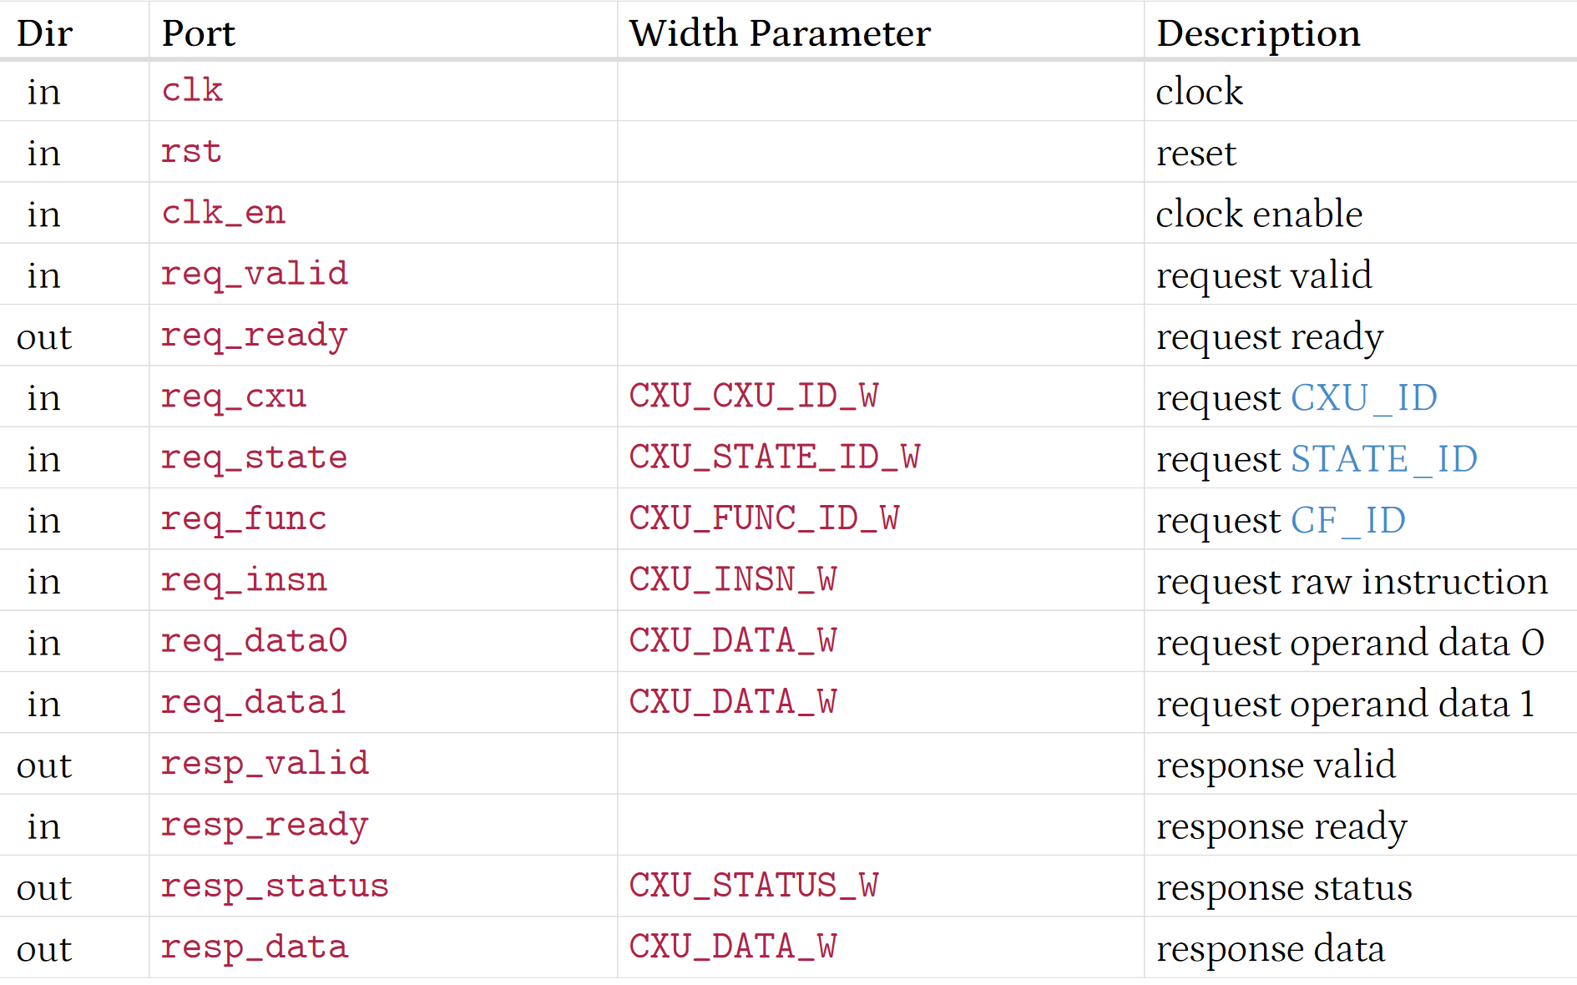
CXU-L2: variable-latency (stream) CXU (§3.7)
Compute function of request and state; send response, in order, later
Flow control: CXU can suspend requests; CPU can suspend responses
Notes:
1 CXU level 2 is for variable latency or streaming CXUs, which compute a function of each request and its state, if any,
2 possibly updating the state and then sending a response, in order, in a later cycle.
3 Both the request and the response have valid-ready handshaking flow control so the CXU can suspend incoming requests and the CPU can suspend incoming responses.
4 Of course this significantly impacts the design of the CPU and the CXU since each must tolerate suspension of request or response channels.
5 This kind of CXU is apt for a pipelined floating Point Unit CXU, which might have a pipelined multiplier with a latency of 3 Cycles,
6 a pipelined adder with a latency of 5 cycles, and an iterative early out divider unit with the variable latency.
7 The waveform at right shows four incoming requests and four outgoing responses, and the effect of handshaking and response latency on those requests and responses.

Slide 43
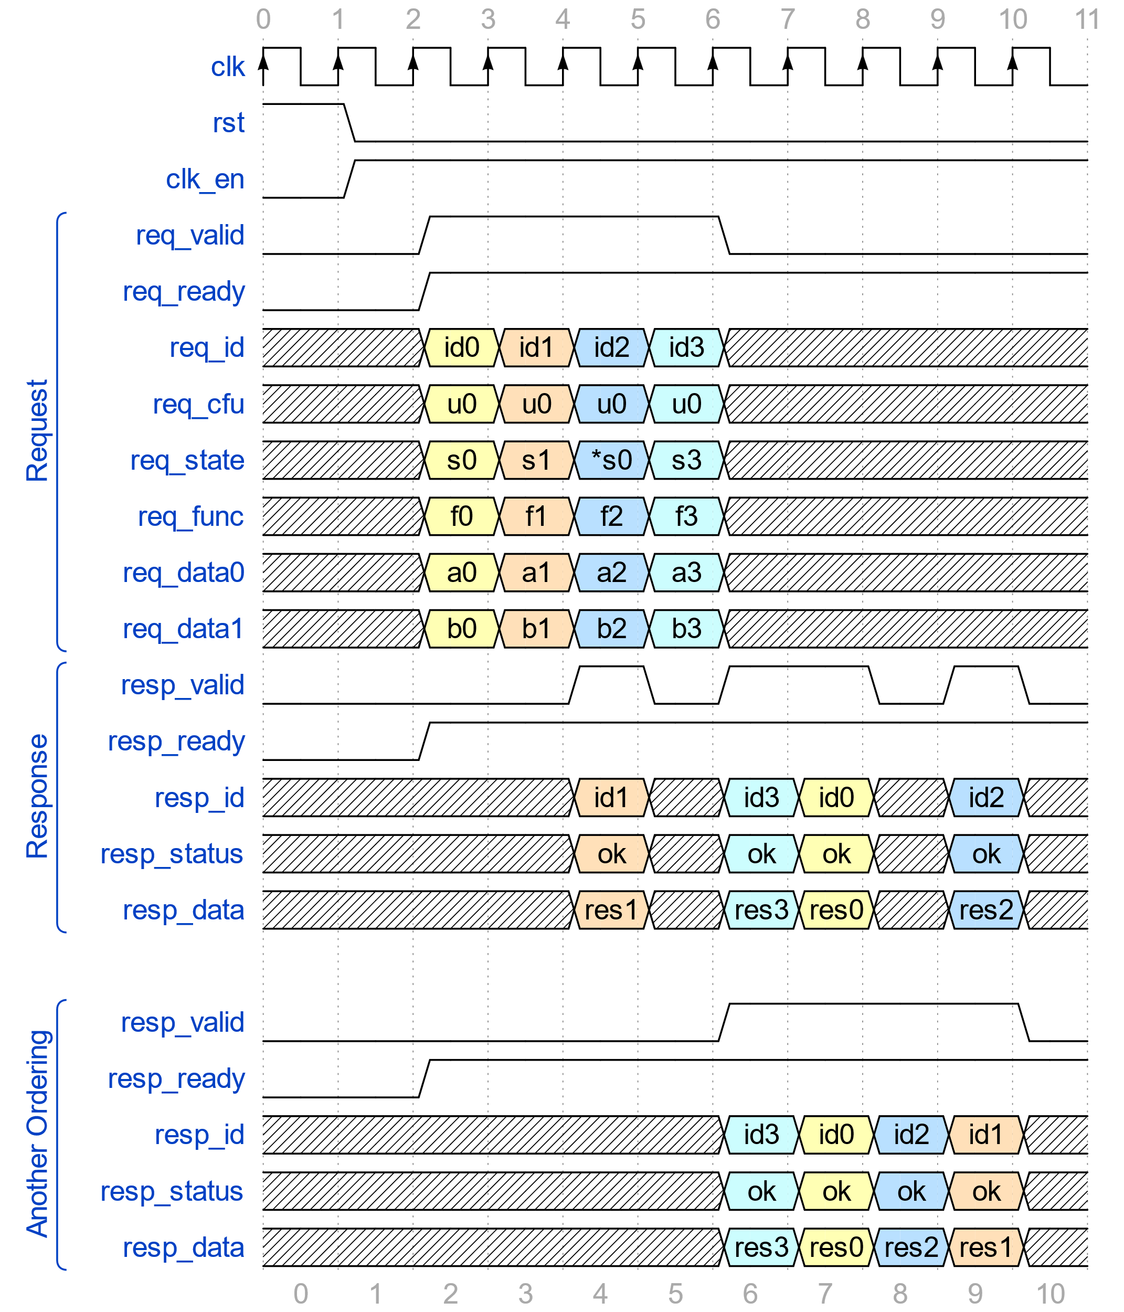
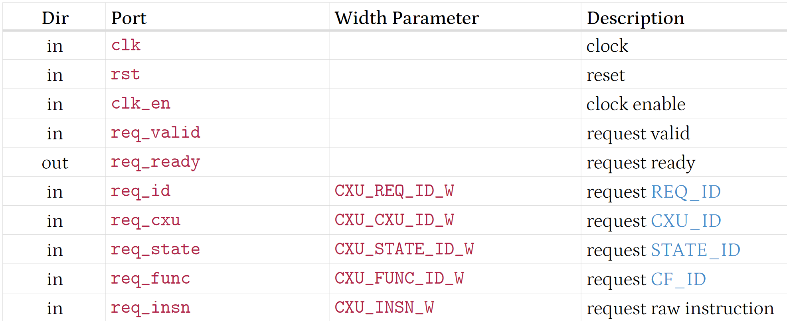
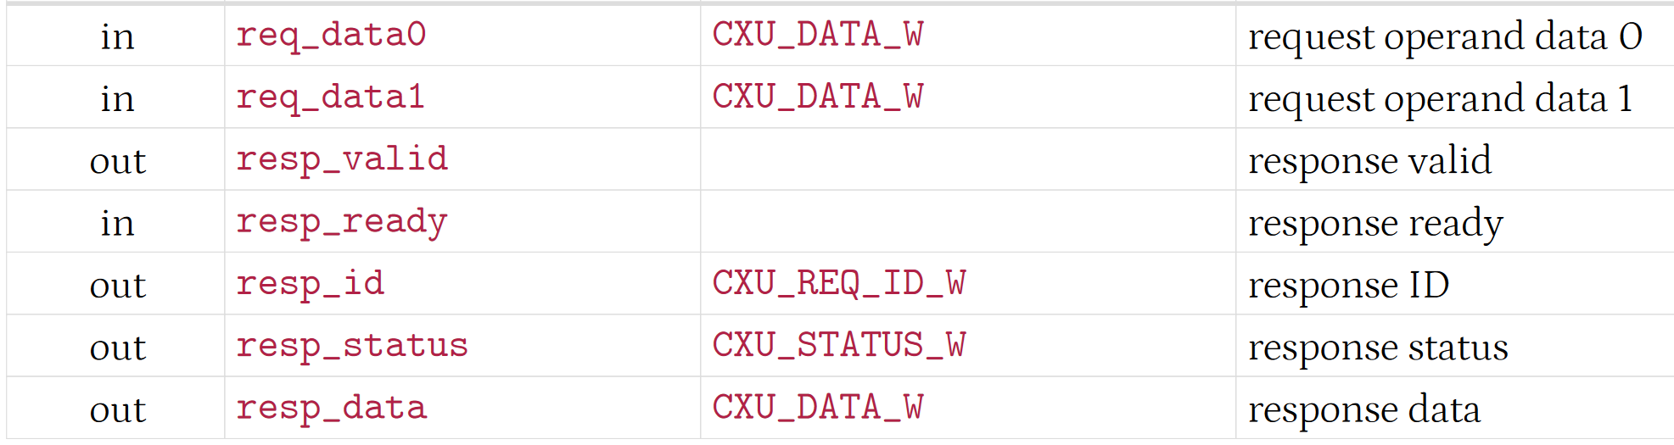
CXU-L3: reordering CXU (§3.8)
Compute func of request and state; send response, possibly out of order
Notes:
1 CXU level 3 is for streaming CXUs that may reorder responses.
2 It still computes a function of the request and state, sending a response, but responses may occur out of request order.
3 This only occurs if the requests are to different state contexts or to a stateless CXU, whereas
4 a series of requests to the same state context are sent in request order.
5 To correlate responses to their requests, CXU L3 adds request and response ID ports.
6 The CXU returns the incoming request ID as its response ID.
7 The stateless pipelined floating Point CXU of the last slide would also be a fine reordering CXU,
8 For example receiving three requests to divide, add, and multiply, but responds out of order, with the product, the sum, then the quotient.
9 This can greatly improve CPU performance, assuming of course the CPU is also CXU level 3 and tolerates out of order responses.

Slide 44
CXU-LI-compliant CPUs (§3.10)
-Zicx CX multiplexing: ⇨CXU requests, ⇦CXU reponses
Composition: CXUs’ levels ≤ CPUs’ levels
Austere single cycle CPU
-L0 combinational CXUs only
Pipelined in-order CPU
-L1 for some fixed latency
-L2, suspend pipeline on req_ready=0, negate resp_ready when regfile WB busy
OoO completion CPU
-L2 or -L3
Notes:
1 CXU-LI compliant CPUs implement -Zicx composable extension multiplexing, issuing custom instructions as CXU requests and accepting CXU responses back.
2 The CPU’s CXU-LI level caps which CXUs may be composed with it. <>
3 For example an austere single cycle CPU implementing CXU level 0 canonly be composed with combinational CXUs.<>
4 Whereas pipelined in-order CPU might Implement level 1, with some fixed CXU_LATENCY that its CXU must match,
5 Or it might Implement level 2 with valid-ready flow control, suspending its pipeline when a CXU negates request ready, and itself negating response ready if there's a cycle in which its register file right back is busy and the response cannot be accepted.<>
6 A complex out of order completion CPU might implement level 2 or 3 enabling those more sophisticated CXUs.

Slide 45
CXU Feature Level Adapters (§3.9)
Translate higher level requests/responses for lower level CXUs
Configurable
Cvt01: combinational -L0 ⇨ pipelined -L1
With CXU_LATENCY-configurable response { valid, status, data } shift register
Cvt02: combinational -L0 ⇨ streaming -L2
With response register + valid-ready logic + suspend reqs while resps suspended
Cvt12: pipelined -L1 ⇨ streaming -L2
With pending responses queue + suspend reqs while queue full & resps suspended
See repo ‘zoo’
Notes:
1 To enable automatic composition CXU-LI provides pre-built feature level adapters
2 Each translates higher feature level requests and responses and forwards them to lower level CXUs.
3 As as with all CXUs, they’re configured with various parameters.
4 The three main adapters are:
5. Convert 0 1 which raises a combinational L0 CXU to a pipelined L1 by adding a configurable CXU-latency response shift register.
6 Convert 0 2 which raises a combinational L0 CXU to a streaming L2 by adding a response register plus valid-ready handshake logic that can suspend incoming requests when it has response data pending but outgoing responses are suspended, and
7 Convert 1 2 which raises a pipelined L1 CXU into a streaming L2 by adding a pending responses queue that buffers pending responses back from the pipelined CXU when outoing responses are suspended.
8 For more details including their RTL implementations please look at the github repo’s Zoo subdirectory

Slide 46
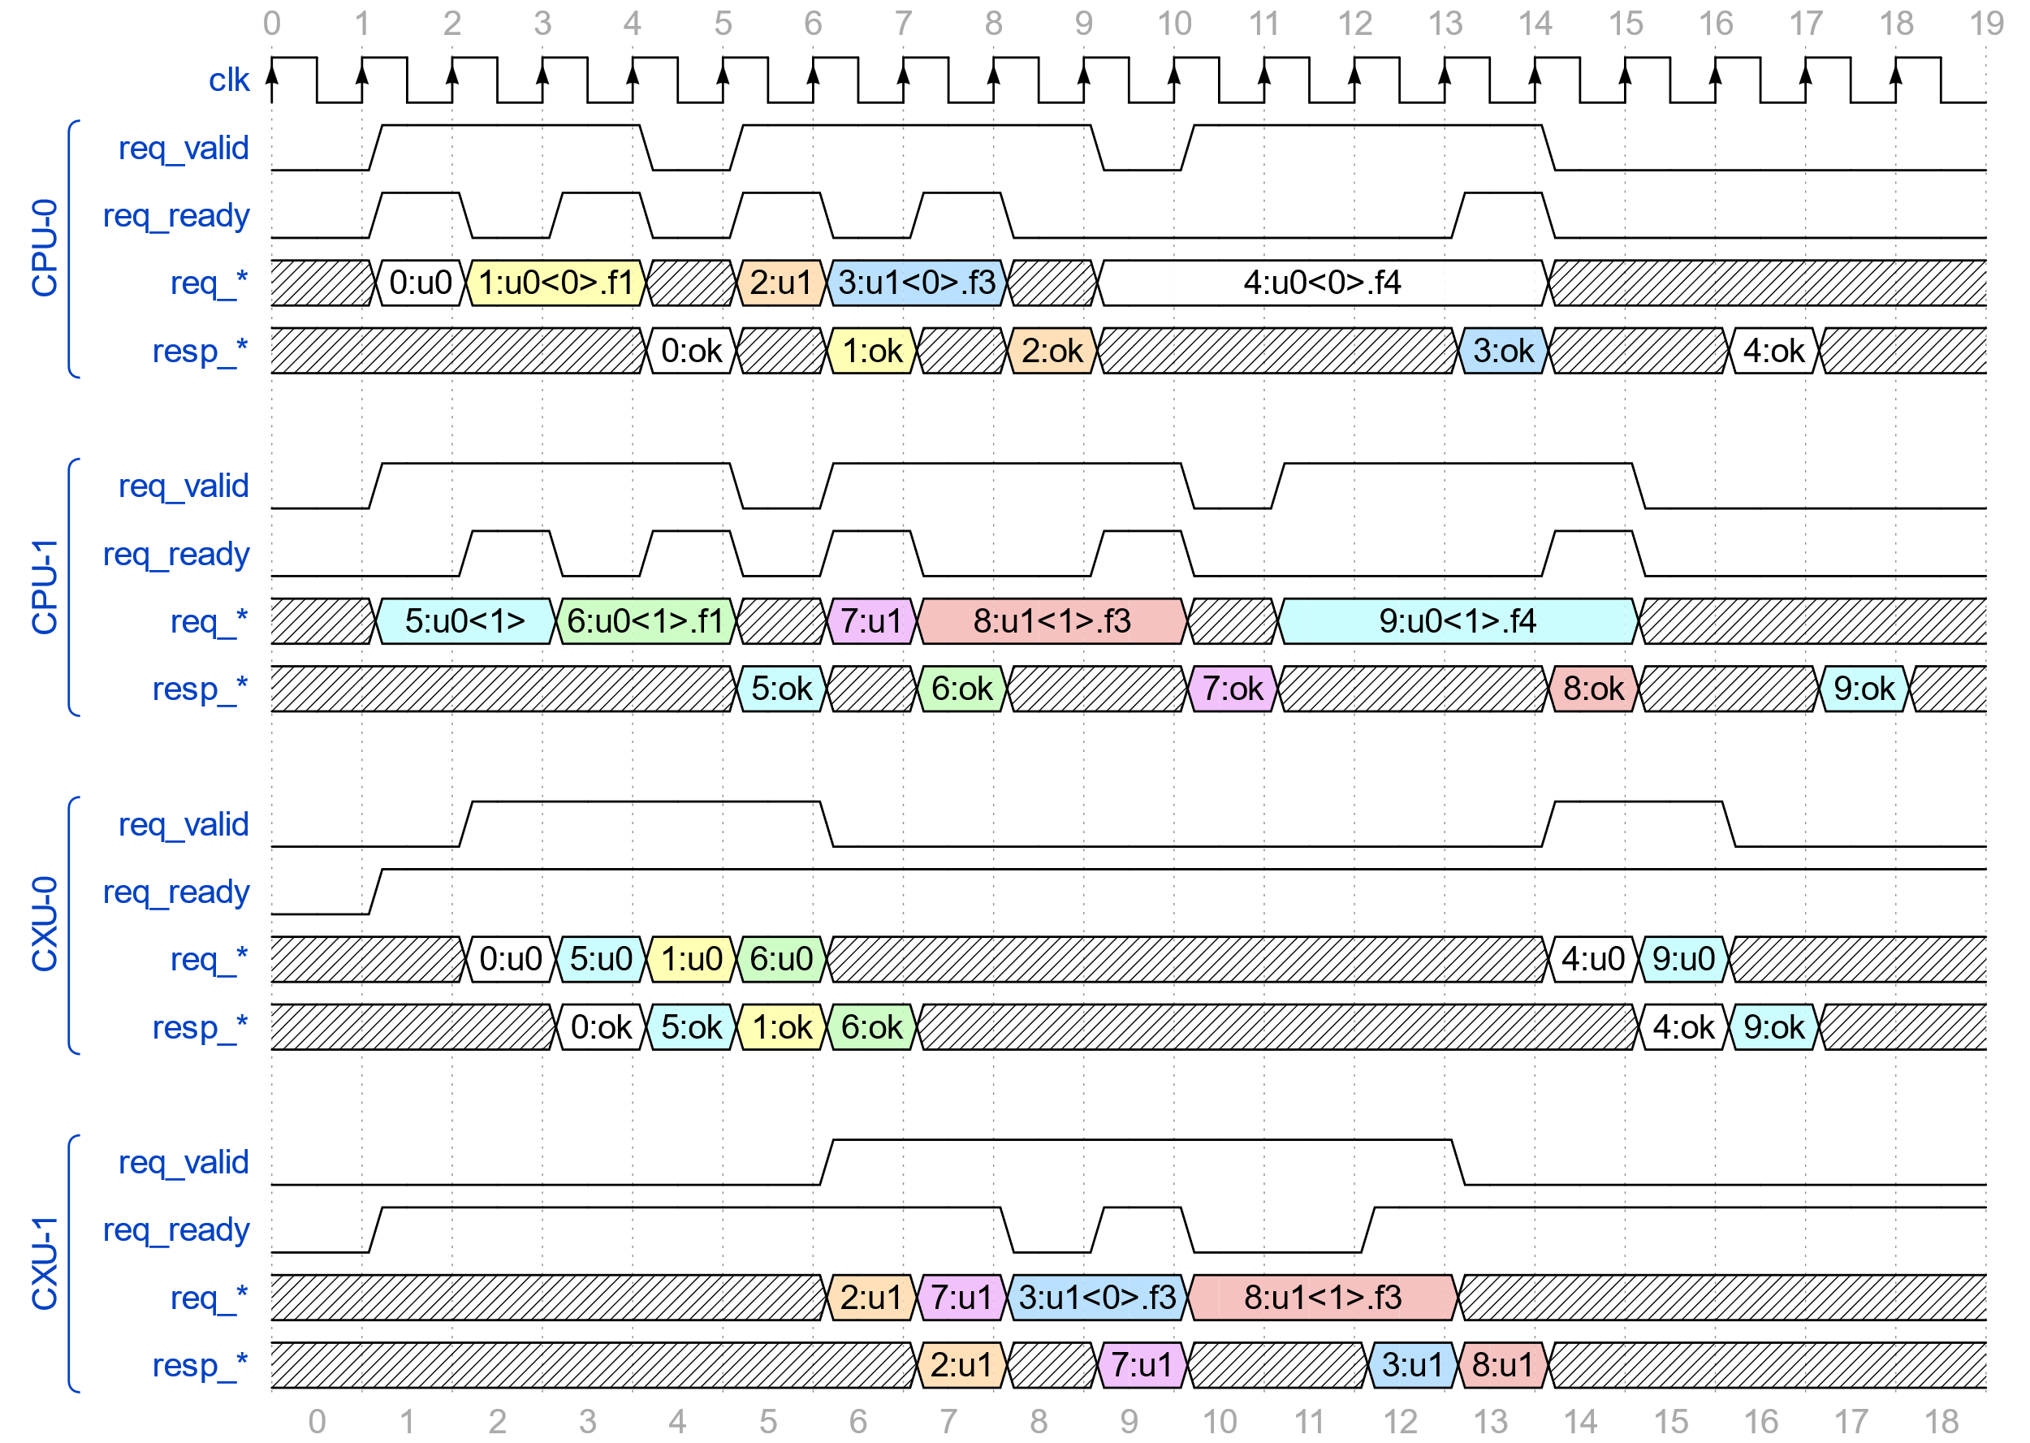
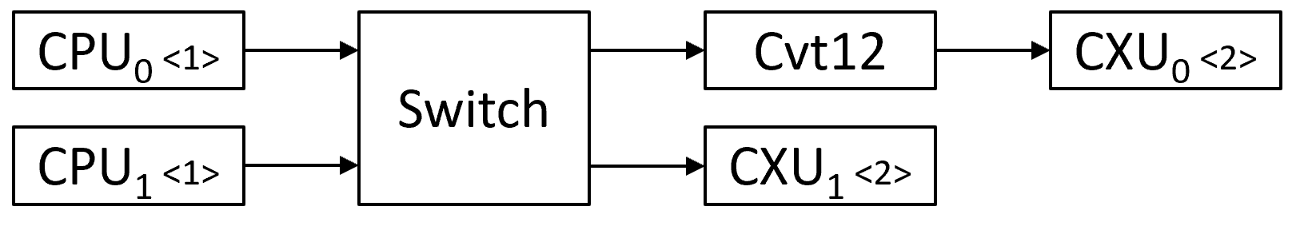
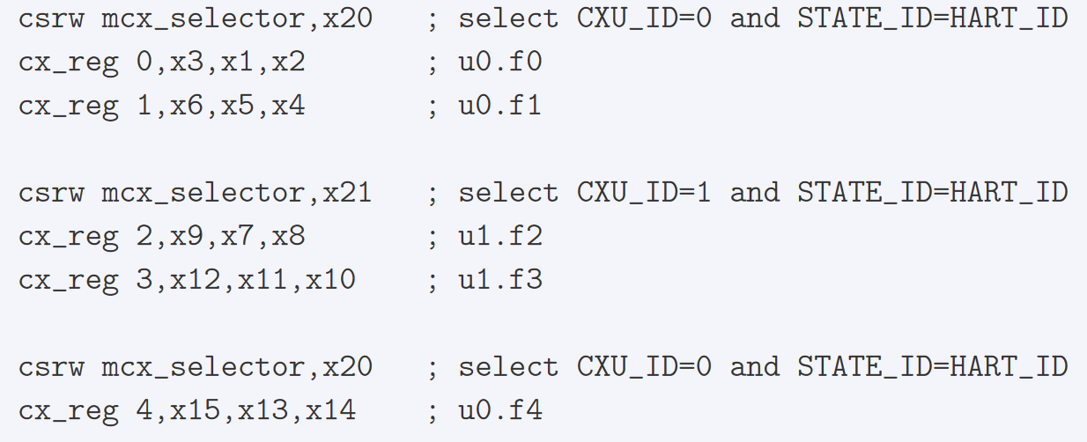
CXU Switch (§3.11)
Configurably compose 1+ initiators with 1+ targets
Transfer eligible inputs to available outputs
Route responses back to request initiators
Ensure each initiator receives in-order responses
Notes:
1 Automatic CXU composition also employs CXU switch cores that are configured to compose one or more initiators with one or more targets at some CXU feature level.
2 Swithces use sets of Arbiters and mulxes to transfer eligible request inputs to available request outputs, routing requests to their downstream CXUs,
3 And similarly to Route incoming downstream CXU responses back up to their respective initiators.
4 This example has two CPU initiators with a a 2x2 switch targeting two CXUs.
5 The code below left is running on each of the CPUs. It writes its hart’s MCX selector for CXU ID 0 and issues two custom instructions, loads MCX selector for CXU ID 1 and issues two more custom instructions, and loads MCX selector with CXU ID 0 again and issues a fifth custom instruction.
6 The busy waveform at right which illustrates the request and response streams and handshakes seen by the two CPUs and the two CXUs.
7 Refer to the spec for more on this.

Slide 47
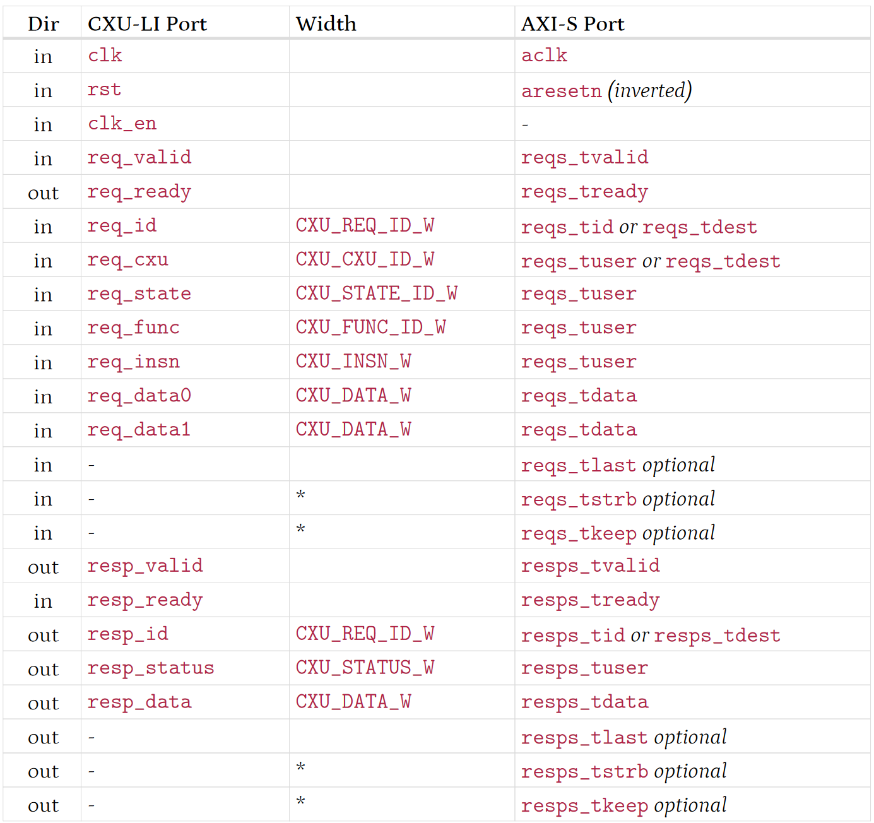
CXU-L2/L3 ⬄ AXI4 Streams (§3.12)
Notes:
1 CXU level 2 and level 3 request and response channels, each with valid-ready handshaking, can map nicely onto two AXI4 streams.
2 This is very useful because modern SOC infrastructure provides many AXI4 system interconnects to transport AXI4 streams about the chip.
3 For example in the AMD Versal devices, the NOC speaks AXI4 streams.
4 Therefore the specification defines a canonical port mapping between the CXU-LI request and response streams and AXI4 request and response streams.
5 This will allow a simple and frugal configurable standard adapter to bridge the CXU-LI world and the AXI4 streams world.

Slide 48
Metadata (§4)
Notes:
1 This concludes the exploration of -Zicx and CXU-LI sections of the spec. From section 4 onward, the rest of the spec is more preliminary and incomplete.

Slide 49
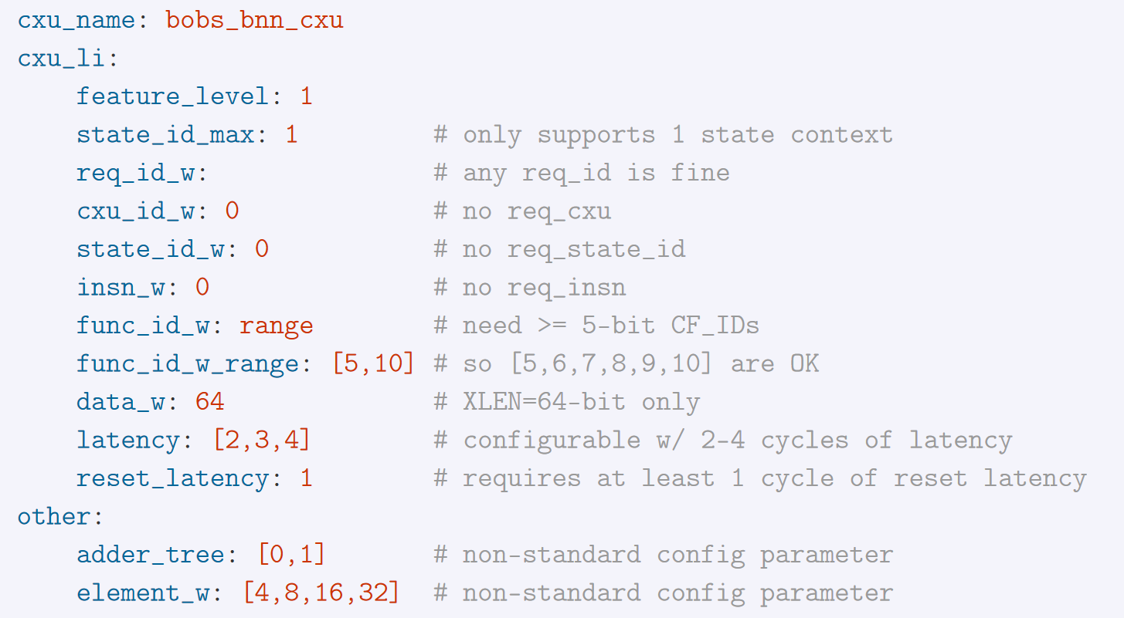
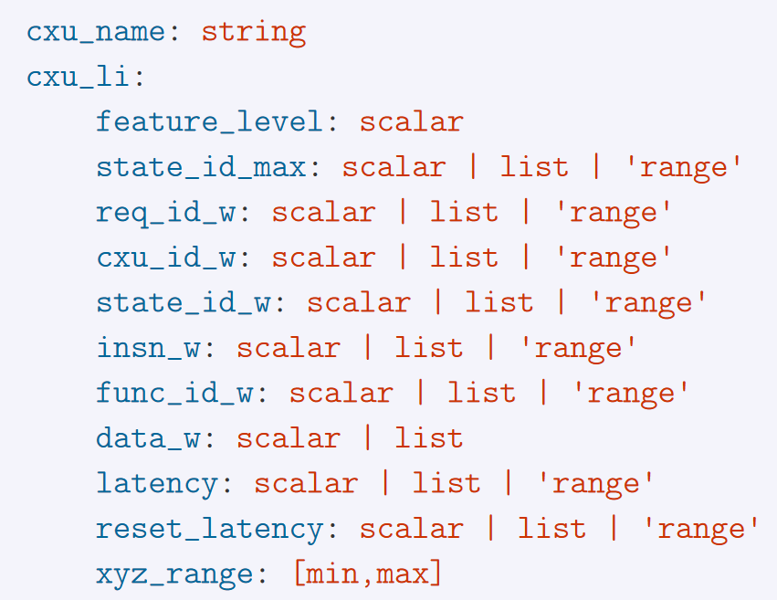
Easier system composition with metadata Preliminary – awaits revision
Each CPU & CXU has metadata: properties, features, CXU-LI parameters
Composer: Σ MDs + manifest ⇨ composed system RTL, CXU Map
Schema: Example CXU MD:
Notes:
1 The design employs metadata to power automatic system composition.
2 Each CPU and CXU RTL module is accompanied with a metadata description of that component's properties features and feasible values for its CXU-LI parameters.
3 Then the composer can input all of the package metadata and the system manifest, solve to find a feasible assignment of all parameters, then emit the composed system RTL and the system CXU map.
4 The spec currently uses YAML for a CXU metadata scheme and to describe CXU parameters, constraints, and properties, such as feature level and number of state contexts.

Slide 50
CX Runtime (§TBD)
Notes:
1 Even though the Composable Extension Runtime library is an essential part of the composable extension HW-SW stack, it is yet to be specified, nor implemented.

Slide 51
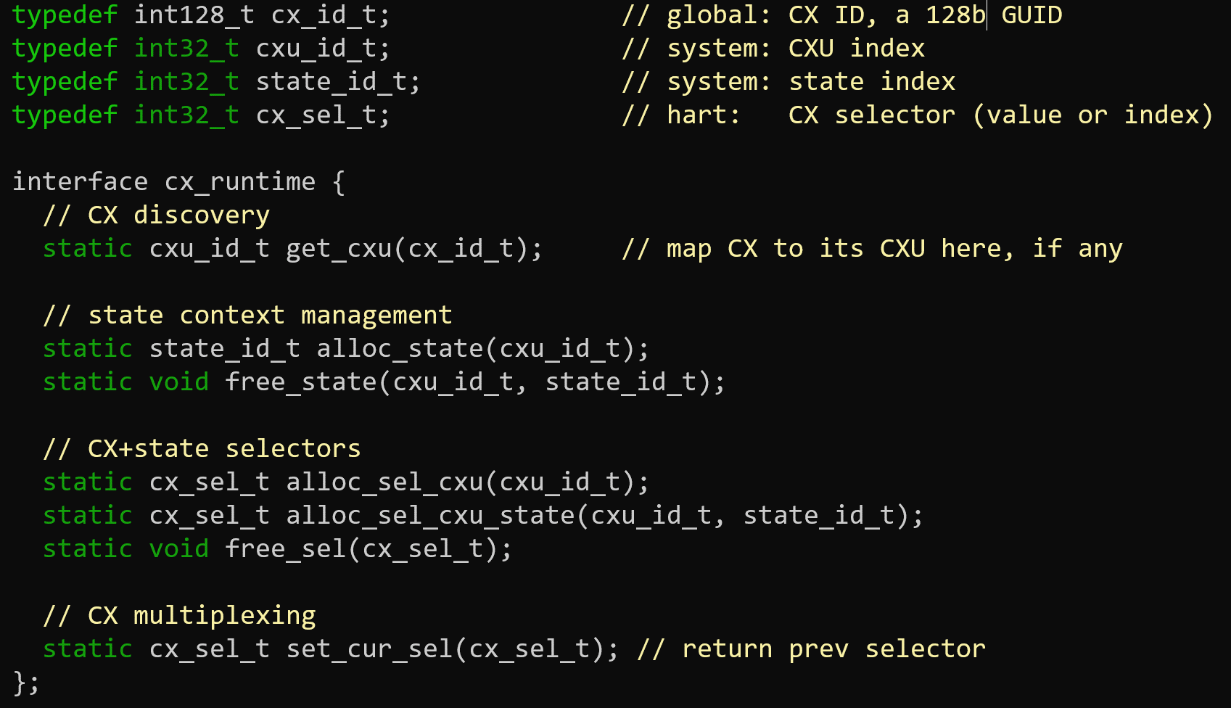
CX Runtime API Preliminary – awaits revision
Notes:
1 However we can describe the minimal set of services that the CX Runtime must implement.
2 This simple cx_runtime interface sketch defines four data types: the CX_ID which is 128-bit GUID and the CXU_ID, STATE_ID, and CX selector are all 32-bit integers.
3 The runtime must provide at least a discovery API to map a CX ID into a CXU ID;
4 State context management functions to allocate and free state IDs (per hart),
5 Selector management to make selector from CXU IDs and state IDs and finally
6 A function to change the hart’s current composable extension selector.
7 This latter function might be an inline assembly function and compile to a CSR write of cx_index or (in machine mode code) mcx_selector.

Slide 52
Status, next steps
Notes:
Where are we and what is left to do?

Slide 53
Status
Draft
V1 TODOs
Spec: first 45 pages
CXU Zoo, CXU adapters
-L0: popcount, bnn
-L1: mulacc, dotprod, cvt01
-L2: cvt02, cvt12, mux, switch
Discuss in RVI sig-soft-cpu, consensus
RVI ISA and non-ISA Task Groups
Overhaul metadata
Design & build CX Runtime, Composer
Explore V2, so V1 doesn’t preclude it
-Zicx + CXU-LI CPU cores
CX libraries for CXU Zoo
Import CFU Playground CFUs into CXU Zoo
Demo: 1 CPU + 2 CXUs + libraries
Plug Fest: CPUs × CXUs × libraries
Verification?
Notes:
1 As of August 2023, we have a solid draft spec for -Zicx and CXU-LI
2 But much more work to do demonstrating the specification in hardware and software.
3 The project repo now includes a CXU Zoo with RTL implementations of some CXUs and CXU adapters.
4 For example, we have a combinational popcount CXU, and a pipelined subword-parallel dot-product CXU,
5 As well as the three level converters, 0-1, 0-2, and 1-2, and a level 2 Switch.
6 Our compelling end goal is a multi CPU, multi CXU, multi library, multi platform “plugfest”, but we still have much to design, implement, and test, to get there.
7 We've restarted discussion in RISC-V International’s SIG-SOFT-CPU group.
8 A renewed consensus will take time.
9 We hope to launch 2 task groups: an ISA one for a -Zicx specs, and a non-ISA one for CXU-LI.
10 We must overhaul the metadata chapter.
11 And build a CX runtime and a simple composer tool.
12 We should discuss forward-looking V2 work, so we don’t paint ourselves into a corner with V1.
13 We need to add -Zicx and CXU-LI ports to a few open source RISC-V soft CPUs.
13 We need some some CX libraries that target our Zoo CXUs, and
14 We need to add more CXU examples to the Zoo. Perhaps adapt some of the CFU Playground CFUs.
15 Much of this is prerequisite for the first demo of correct automatic composition of 1 CPU + 2 CXUs + CX libraries.
16 Then several more CPUs, custom extensions, CXUs, and CX libraries are needed to enable the mix-and-match plug fest.
17 Once we have first plug fest the composable extension ecosystem will be well underway and eventually its network effects will lead most CPU, custom extension, and library developer to adopt these common standards.

Slide 54
Call to Action
We propose two new RISC-V International Task Groups:
CX-ISA TG: -Zicx ISA/CSRs to enable composable extensions
CXU-LI TG: (non-ISA) logic interface for CX hardware
We submit:
Draft Proposed RISC-V Composable Custom Extensions Specification https://github.com/grayresearch/CX
Questions? Suggestions? Criticism? Discuss as github repo issues, or in RVI sig-soft-cpu group
Notes:
1 Finally! One last slide.
2 If you think the RISC-V ecosystem would be stronger if multiple agile composable custom extensions can coexist correctly in one system,
3 If you think it should be painless to add another composable extension into your system
4 If you want every new RISC-V CPU core to have immediate access to a rich catalog of custom extension packages and extension libraries,
5 If you want applications that use composable extensions to just work, to keep working over the years, and to be easy to integrate new versions of extensions,
6 If you are concerned that RISC-V may be adding too many standard extensions to the enduring complexity of the platform,
7 If you think we all ought to be able to share and build on each other’s good work,
8 If you think we need fewer silos and less fragmentation of the ecosystem,
9 Then I hope you will participate in or at least support our proposal to start new 2 new RISC-V International task groups,
10 CX-ISA task group: ISA work to enable composable extensions, and CXU-LI task group: a logic interface for composable extensions hardware
11 For our part we will submit our draft composable extensions specification.
12 So, what do you think? Do you have questions, suggestions ,or criticism?
13 Please let us know, via a GitHub repo issue, or (for now) in the RISC-V International SIG-SOFT-CPU group.
14 I hope to see you there! Thank you very much for your interest, and have a great day.

